Slide 1
Arduino
Programming Things

Slide 2
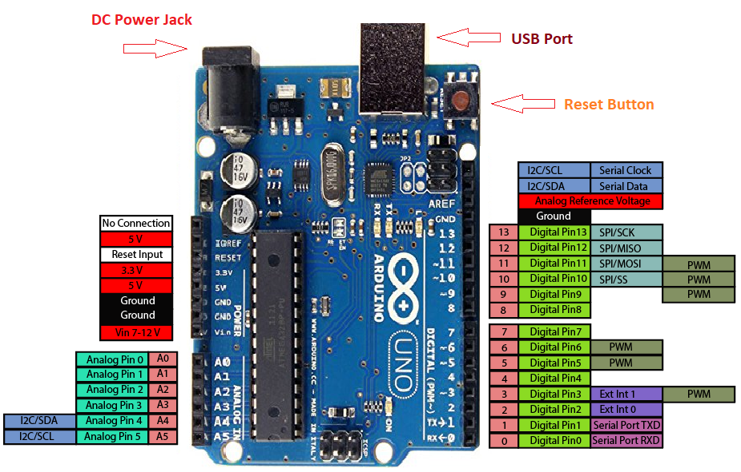

Arduino
Interface - Pinout

Slide 3
IDE Overview

Slide 4
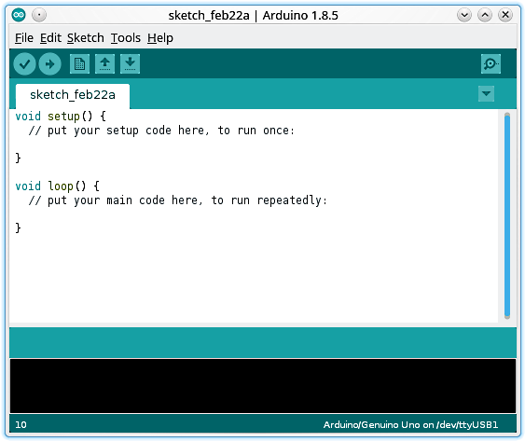
Arduino
IDE
Sketch Name with
Date
IDE Version
Serial Monitor
Menu Bar
Tab Functions
Verify Sketch
Upload Sketch to
Board
New Sketch
Editor
Open Sketch
Save Sketch
Output Window
Cursor Position
Board / Port Info

Slide 5
Arduino
Sketch - Default
All one time initialization goes
here. For example,
Configuration of DDR register
Serial port setup etc.,
The application code, which
should loop forever should be
put here

Slide 6
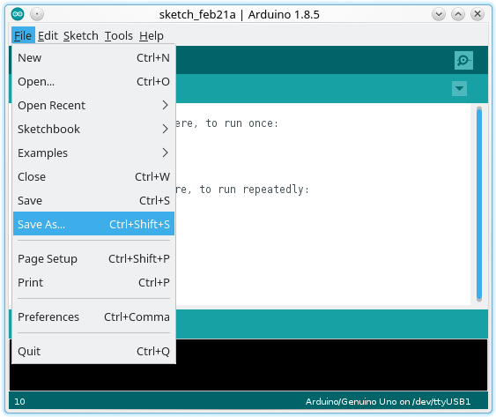
Arduino
Sketch – Save As

Slide 7
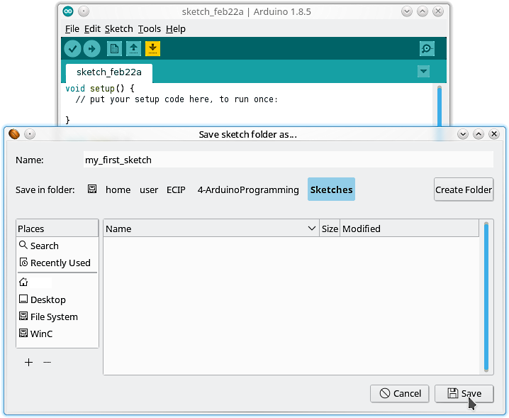
Arduino
Sketch – Save As

Slide 8

Arduino
Sketch – Save As
Saved Sketch as

Slide 9
Thank You

